Slide 1
DMJ Engineering Program Tooling
Teradata Inventory Scripts
Overview and Guidance
Data Migration Jumpstart Engineering Team

Slide 2
Overview of Scripts
An inventory scripts that collects information from a Teradata system about databases, objects, columns and space at database and table level
Scripts are ran from an ODBC client (e.g., SQL Assistant), JDBC client (e.g., Teradata Studio) or native BTEQ client
Output can be exported to .csv file by adjusting the configuration of the client used to run the scripts
Scripts and output help provide structured approach and process for customer Teradata migration workshops and assessments
Data Migration Jumpstart Engineering Team

Slide 3

Objects and Schema Items Inventoried
Databases
Tables
Columns
Functions
JAR
Stored procedures
Triggers
Methods
Indexes
Journals
Foreign server objects
Table operators
Macros
User-defined types
Views
Authorizations
GLOP sets
Data Migration Jumpstart Engineering Team

Slide 4
Running the Scripts
Run the scripts from an ODBC client (e.g., SQL Assistant), JDBC client (e.g., Teradata Studio) or native BTEQ client
Note: User must have read rights on DBC user
Execute every query one after another in a client. Configure the output to download the data to a .csv file.
Data Migration Jumpstart Engineering Team

Slide 5
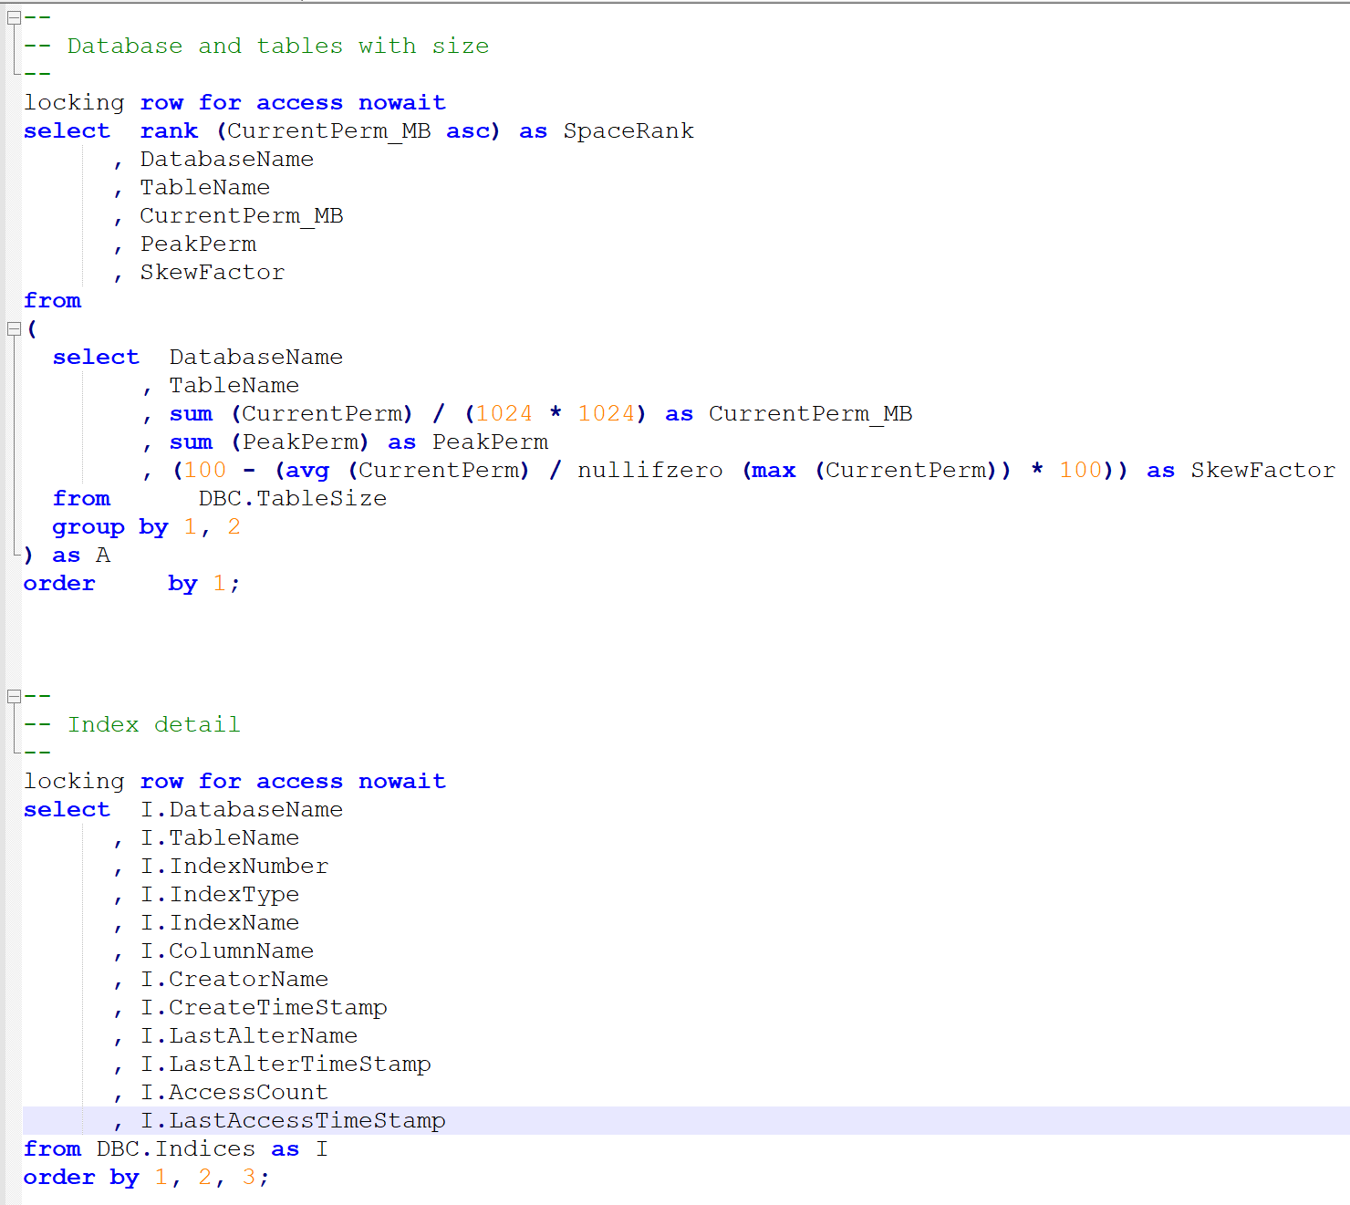
Code Snippet
Data Migration Jumpstart Engineering Team

Slide 6
Bibliography
Teradata Communities – Blogs, discussion, download JDBC driver and Teradata Studio
Teradata Documentation – Official Teradata site with documentation of all their products, including the database and clients
Teradata Manuals in DMJ Program Sharepoint
Data Migration Jumpstart Engineering Team

